Slide 1
Maratha Empire

Slide 2
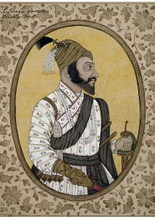
Chhatrapati Shivaji
Shivaji was born in the hill-fort of Shivneri, near the city of Junnar in Pune district on 6 April 1627 or 19 Feb. 1630
Shivaji carved out an enclave from the declining Adilshahi sultanate of Bijapur that formed the genesis of the Maratha Empire
In 1674, he was formally crowned as the Chhatrapati (Monarch) of his realm at Raigad.
Shivaji established a competent and progressive civil rule and He innovated military tactics, pioneering the guerrilla warfare methods.

Slide 3
Combats/Battles of Shivaji
In 1645, the 15-year-old Shivaji bribed or persuaded the Bijapuri commander of the Torna Fort, Inayat Khan, to hand over the possession of the fort to him
In 1659, Adilshah sent Afzal Khan, two met in a hut at the foothills of Pratapgad fort on 10 November 1659. The arrangements had dictated that each come armed only with a sword, and attended by a follower.
In the ensuing Battle of Pratapgarh fought on 10 November 1659, Shivaji's forces decisively defeated the Bijapur Sultanate's forces. The agile Maratha infantry and cavalry inflicted rapid strikes on Bijapuri units
This unexpected and unlikely victory made Shivaji a hero of Maratha folklore and a legendary figure among his people.

Slide 4
...Combats/Battles of Shivaji
To counter the loss at Pratapgad and to defeat the newly emerging Maratha power, another army, this time numbering over 10,000, was sent against Shivaji, commanded by Bijapur's Abyssinian general Rustam Zaman. With a cavalry force of 5,000 Marathas, Shivaji attacked them near Kolhapur on 28 December 1659. In a swift movement, Shivaji led a full frontal attack at the centre of the enemy forces while two other portions of his cavalry attacked the flanks. This battle lasted for several hours and at the end Bijapuri forces were soundly defeated and Rustamjaman fled the battlefield.
Siege of Panhala and Battle of Pavan Khind.

Slide 5
Attack on Shaista Khan
Upon the request of Badi Begum of Bijapur, Aurangzeb sent his maternal uncle Shaista Khan, with an army numbering over 150,000 along with a powerful artillery division in January 1660 to attack Shivaji in conjunction with Bijapur's army led by Siddi Jauhar. Shaista Khan, with his better-equipped and -provisioned army of 300,000 seized Pune
In April 1663, Shivaji launched a surprise attack on Shaista Khan in Pune, They overcame the palace guards, breached the wall, and entered Shaista Khan's quarters, killing those they found there. Shaista Khan escaped, losing his thumb in the melee

Slide 6
Arrest in Agra and escape
In 1666, Aurangzeb invited Shivaji to Agra, along with his nine-year-old son Sambhaji. Aurangzeb's plan was to send Shivaji to Kandahar, now in Afghanistan, to consolidate the Mughal empire's northwestern frontier. However, in the court, on 12 May 1666, Aurangzeb made Shivaji stand behind mansabdārs (military commanders) of his court. Shivaji took offence and stormed out of court and was promptly placed under house arrest under the watch of Faulad Khan, Kotwal of Agra.
Shivaji feigned severe illness and requested to send most of his contingent back to the Deccan, thereby ensuring the safety of his army and deceiving Aurangzeb. Thereafter, on his request, he was allowed to send daily shipments of sweets and gifts to saints, fakirs, and temples in Agra as offerings for his health. After several days and weeks of sending out boxes containing sweets, Sambhaji, being a child had no restrictions and was sent out of the prison camp and Shivaji, disguised as labourer carrying sweet basket escaped on 17 August 1666.

Slide 7
Death and succession
The question of Shivaji's heir-apparent was complicated by the misbehaviour of his eldest son Sambhaji, who was irresponsible and "addicted to sensual pleasures." Unable to curb this, Shivaji confined his son to Panhala in 1678
Sambhaji then returned home, unrepentant, and was again confined to Panhala
In late March 1680, Shivaji fell ill with fever and dysentery dying around 3–5 April 1680 at the age of 52 on the eve of Hanuman Jayanti. Rumours followed his death, with Muslims that he had died of a curse from Jan Muhammad of Jalna, and some Marathas whispering that his second wife, Soyarabai, had poisoned him so that his crown might pass to her 10-year-old son Rajaram.

Slide 8
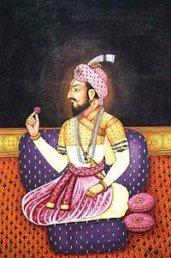
Sambhaji....Rajaram...Tarabai
After Shivaji's death, the widowed Soyarabai made plans with various ministers of the administration to crown her son Rajaram rather than her prodigal stepson Sambhaji. On 21 April 1680, ten-year-old Rajaram was installed on the throne. However, Sambhaji took possession of the Raigad Fort after killing the commander, and on 18 June acquired control of Raigad, and formally ascended the throne on 20 July. Rajaram, his wife Janki Bai, and mother Soyrabai were imprisoned, and Soyrabai executed on charges of conspiracy that October.
Soon after Shivaji's death, the Mughals attempted to invade it, but could not subdue the Marathas and it resulted in a war of 27 years from 1681 to 1707 ending in the defeat for the Mughals.

Slide 9
Shahu
Shahu, a grandson of Shivaji was kept prisoner by Aurangzeb during the War of 27 years. After the latter's death, his successor released Shahu. After a brief power struggle over succession with his aunt Tarabai, Shahu ruled the Maratha Empire from 1707 to 1749
During this period, he appointed Balaji Vishwanath Bhat as Peshwas
After the death of the Mughal Emperor Aurangzeb, the empire expanded greatly under the rule of the Peshwas.

Slide 10
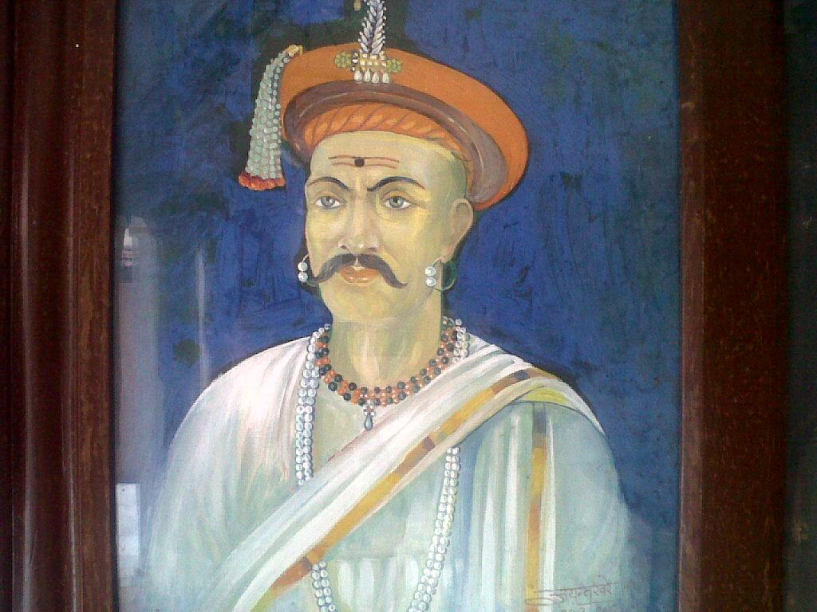
Peshwa Era :Balaji Vishwanath
Shahu appointed the Peshwa Balaji Vishwanath in 1713. From his time, the office of Peshwa became supreme while Shahuji became a figurehead
His first major achievement was the conclusion of the Treaty of Lanavala in 1714 with Kanhoji Angre, the most powerful naval chief on the Western Coast. He later joined the Marathas.
In 1719, an army of Marathas marched up to Delhi along with Sayyid Hussain Ali, the Mughal governor of Deccan and managed to depose the Mughal emperor. Thus, Marathas realised for the first time their potential to "make and unmake" Mughal Emperors.

Slide 11
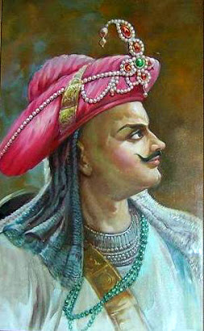
Baji Rao I
After Balaji Vishwanath's death in April 1720, his son, Baji Rao I, was appointed Peshwa by Shahu.
Bajirao is credited with expanding the Maratha Empire tenfold from 3% to 30% of the modern Indian landscape during 1720-40.
He fought over 41 battles before his death in 1740 and is reputed to have never lost one.

Slide 12
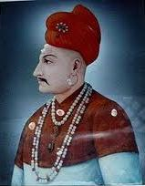
Balaji Baji Rao
Baji Rao's son, Balaji Bajirao (Nanasaheb), was appointed as the next Peshwa by Shahuji
Balaji Bajirao encouraged agriculture, protected the villagers, and brought about a marked improvement in the state of the territory. Continued expansion saw Raghunath Rao, the brother of Nanasaheb, pushing into in the wake of the Afghan withdrawal after Ahmed Shah Abdali's plunder of Delhi in 1756. Delhi was captured by Maratha army under Raghunath Rao in August 1757 defeating Afghan garrison in the Battle of Delhi. This laid the foundation for the Maratha conquest of North-west India. Rajputana also came under Maratha domination during this time.

Slide 13
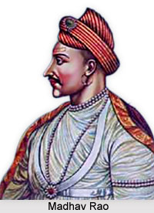
Peshwa Madhav Rao I
Peshwa Madhavrao I was the fourth Peshwa of the Maratha Empire. It was during his tenure that the Maratha Resurrection took place. He worked as a unifying force in the Maratha Empire and moved to the south to subdue Nizam and Mysore to assert Maratha power.
He sent generals such as Bhonsle, Scindia, and Holkar to the north, where they re-established Maratha authority by the early 1770s.
His death is considered to be the most fatal blow to the Maratha Empire and from that time Maratha power started to move on a downward trajectory with working as a confederacy than an empire. He died at the age of 27 in 1772.

Slide 14
In a bid to effectively manage the large empire, Madhavrao Peshwa gave semi-autonomy to the strongest of the knights. After the death of Peshwa Madhavrao I, various chiefs and statesman became de facto rulers and the Peshwa was relegated to a secondary position and became the ceremonial king. Thus, the semi-autonomous Maratha states came into being in far-flung regions of the empire:
Peshwas of Pune
Gaekwads of Baroda
Holkars of Indore
Scindias of Gwalior (Chambal region) and Ujjain (Malwa Region).
Bhonsales of Nagpur (no blood relation with Shivaji's or Tarabai's family)
Puars (or Pawars) of Dewas & Dhar
Even in the original kingdom of Shivaji itself, many knights were given semi-autonomous charges of small districts, which led to princely states Sangli, Aundh, Bhor, Bawda, Phaltan, Miraj, etc. Pawars of Udgir were also part of confederacy.

Slide 15
THANK YOU!!

